Slide 1
Tesla-Quality Control and Production Optimization in the Automotive Sector
Ali Görkem Yalçın

Slide 2
Challenge
Scaling EV production due to market growth while maintaining top-tier standards
Multidimensional strategy integrating data across the entire product lifecycle: Design -> Manufacturing -> QA -> Delivery

Slide 3
Approach
Using data to ensure quality control and detect defects
Using data analysis – machine learning to examine sensor data, production records, and quality measures in real time
Identifying deviations from normal executions to address irregularities.
Predictive maintenance techniques to optimize equipment performance at manufacturing plants
Forecasting and planning the maintenance of factory machinery to prevent unexpected interruptions(involuntary vacation days)

Slide 4
Approach
Using data analytics, Tesla finds possibilities to streamline production processes and, also bottlenecks as well
Putting automation technologies, robots, AI driven solutions which can scale production volumes by reducing cycle times
Utilizing machine learning algorithms to examine manufacturing data and identify the root causes of defects

Slide 5
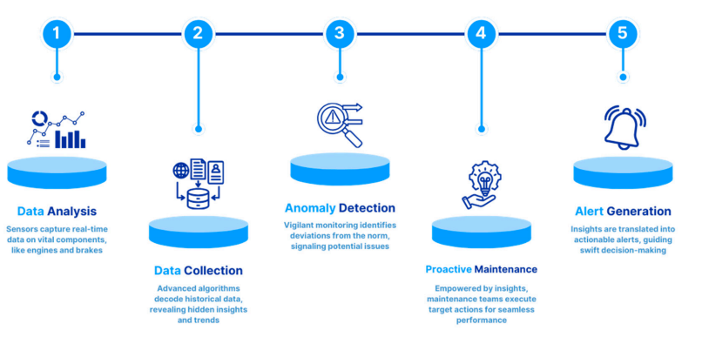
Outcome
Leveraging big data for quality control and process optimization, Tesla achieved 20% reduction in manufacturing defects and 30% improvement in production efficiency
Delivering high quality vehicles at scale

Slide 6
Challenges and Future Research Directions – Edge Computing
Shifting the focus away from cloud -> edge devices
Minimizing the latency – network overhead
Reducing the dependency to cloud

Slide 7
Advantages of Edge Computing
Real-time responsiveness, necessary in autonomous vehicles – instant decision-maker products
Provides increased(!) data privacy and security
Reducing the exposure of data during transmission – storage -> minimizing the risk of data breaches – unauthorized access
Lowering the attack surface

Slide 8
Disadvantages of Edge Computing
Managing the same product with different devices with different capabilities(mobile phone models)
Security is still needed; effective encryption is a must. Devices can get stolen
Battery problems, biometrics, Tesla, “green energy”

Slide 9
Summary
Edge Computing | Shifting data processing and analytics closer to data sources (IoT devices, sensors, edge servers) rather than relying solely on centralized cloud servers.
Advancements | Enables real-time analytics and decentralized decision-making. Enhances data privacy and security by processing data at the network edge.
Challenges | Managing different edge devices and resources efficiently. Addressing security concerns related to data storage at the edge device. Inefficient battery usage

Slide 10
Questions

